Slide 1


Town of Middleburg
PUBLIC INFORMATION MEETING
APRIL 19, 2022

Slide 2
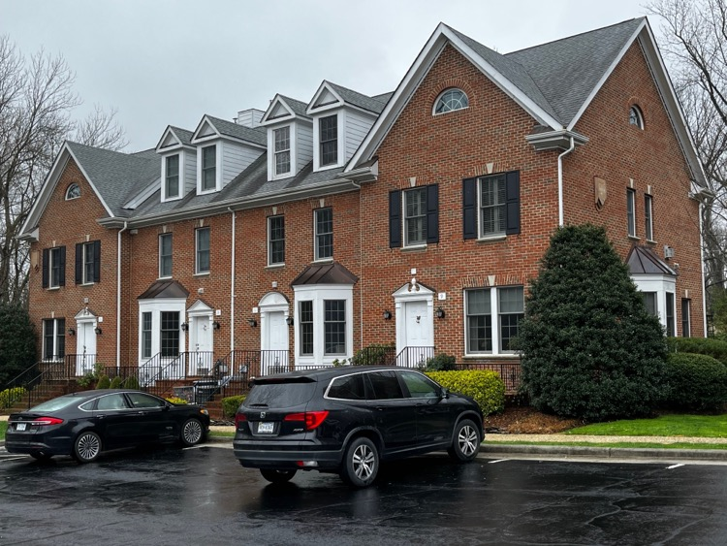
MEETING OVERVIEW:
Challenges Facing Middleburg
Proposals for Annexation/BLA
  Windy Hill Foundation
    (Will then take a 10-minute break)
  Homewood Farm (Pettibone Property)
Considerations & Next Steps
Questions & Answers (at end)
Goal of Session: Provide information, answer questions, obtain feedback – No decisions today

Slide 3

Challenges Facing Middleburg

Slide 4
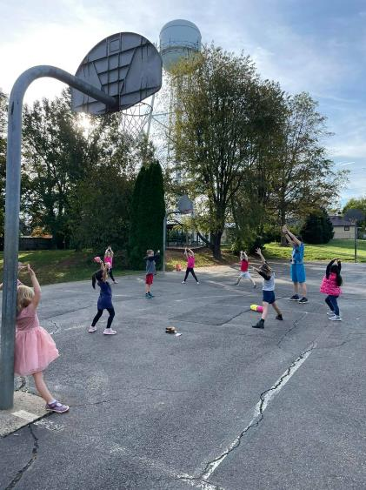
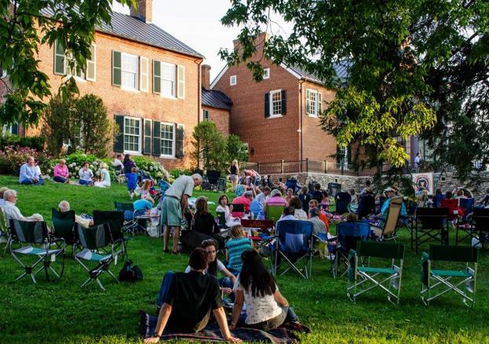

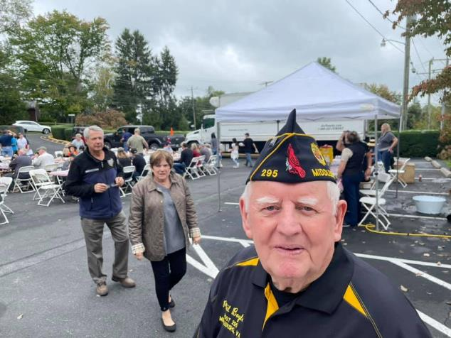
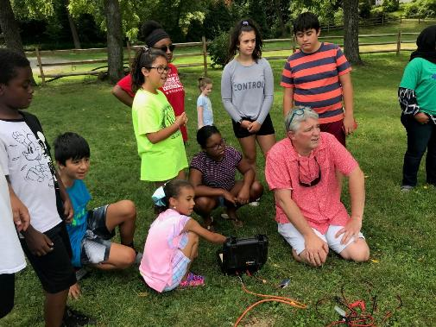
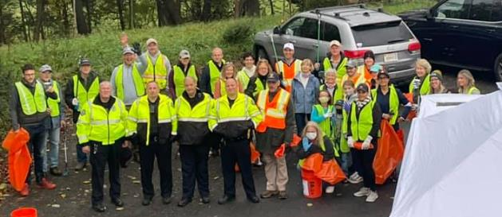
The Character of our Town & Community

Slide 5
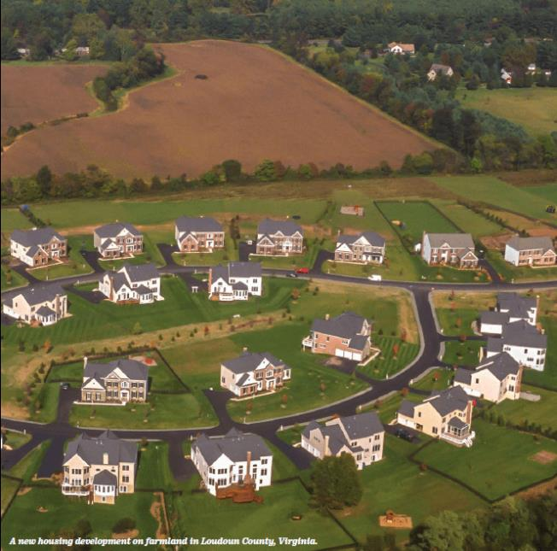
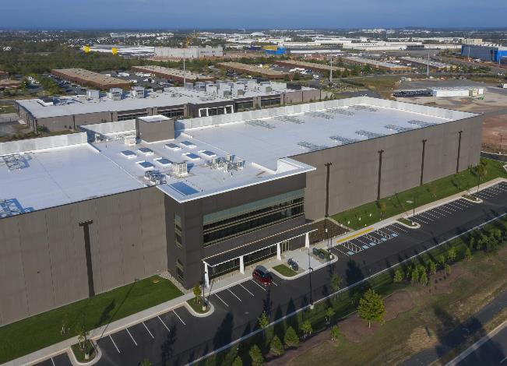
Growth and Land Use Pressures Around Us
Loudoun’s growth continues to push westward
Negative consequences for our community:
  Cluster development and encroachment
  Data Centers in Lenah
  By-right development under Loudoun County Zoning
County Zoning Rewrite
  Cannot trust that the County will solve these problems

Slide 6
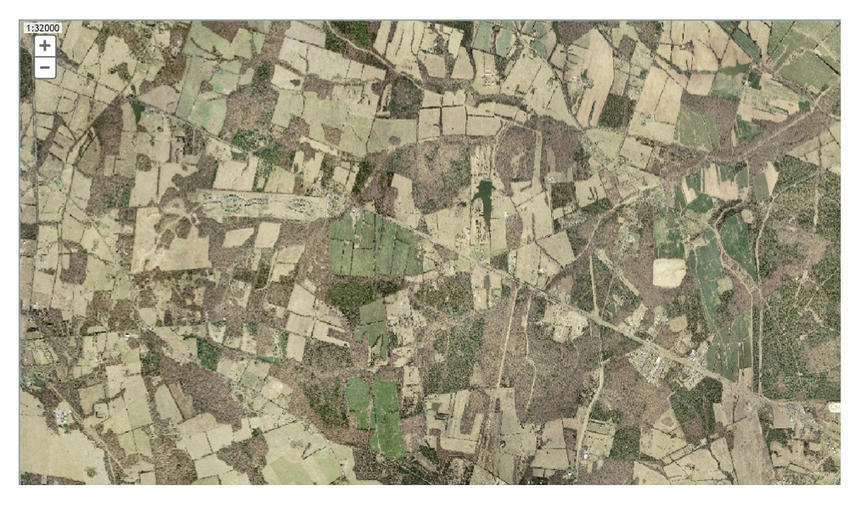
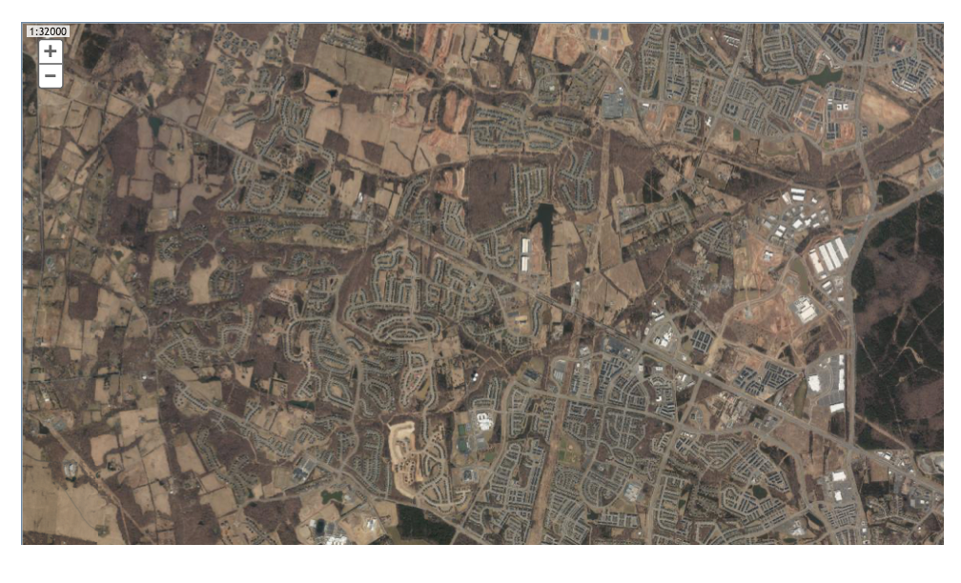
Gilbert’s
Corner
Route 15
Route 50
606/ Loudoun Cty Pkwy
2002
2021

Slide 7
AR-2 County Zoning – Permitted Uses
  Animal Husbandry
  Agricultural Processing
  Agri-Education
  Animal Care Business
  Agritainment/Eco-tourism
  Commercial Winery
  Custom operators
  Direct to customer sales / PYO use
  Equestrian Event Facility
  Farm Co-ops
  Farm Machinery Repair
  Farm Markets
  Feedlot
  Limited Brewery
  Nursery, production
  Pet farms
  Retail Shops/Restaurant
  Stable, Livery
  Stable, Private
  Vet Services
  Virginia Farm Winery
  Wayside Stand
  Agricultural research facility
  Central farm distribution hub
  Portable dwelling/trailer construction
  Co-housing
  Arboretum
  Botanical garden
  Community/regional park
  Fire/Rescue/Police Station
  Church/religious building
  Rural corporate retreat
  Rural recreation establishment
  Country Inn (up to 100 people)
  Cellular tower

Slide 8
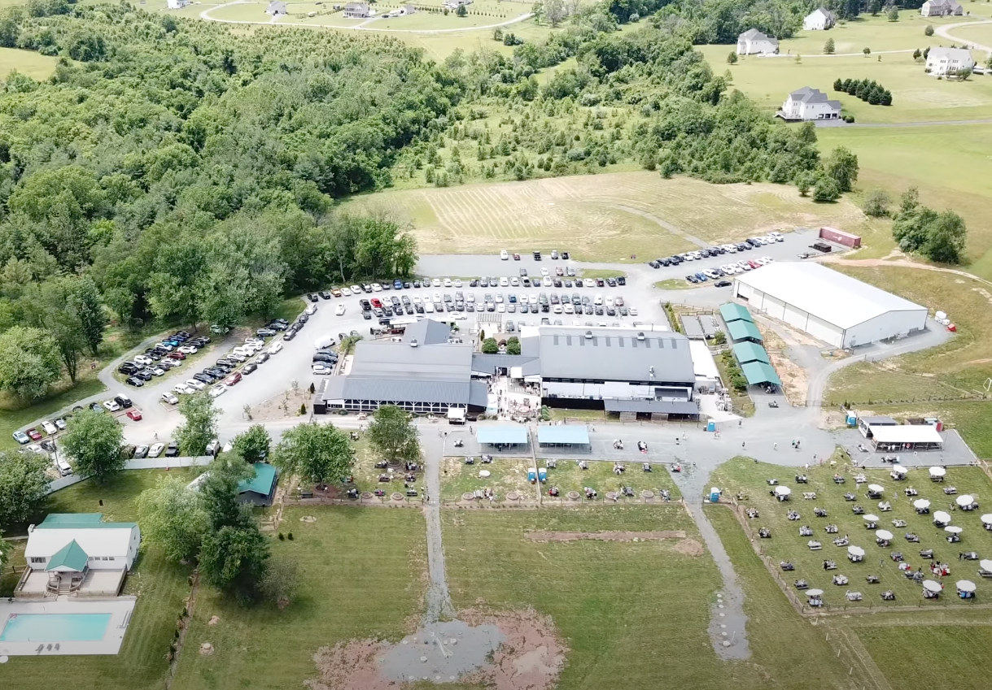
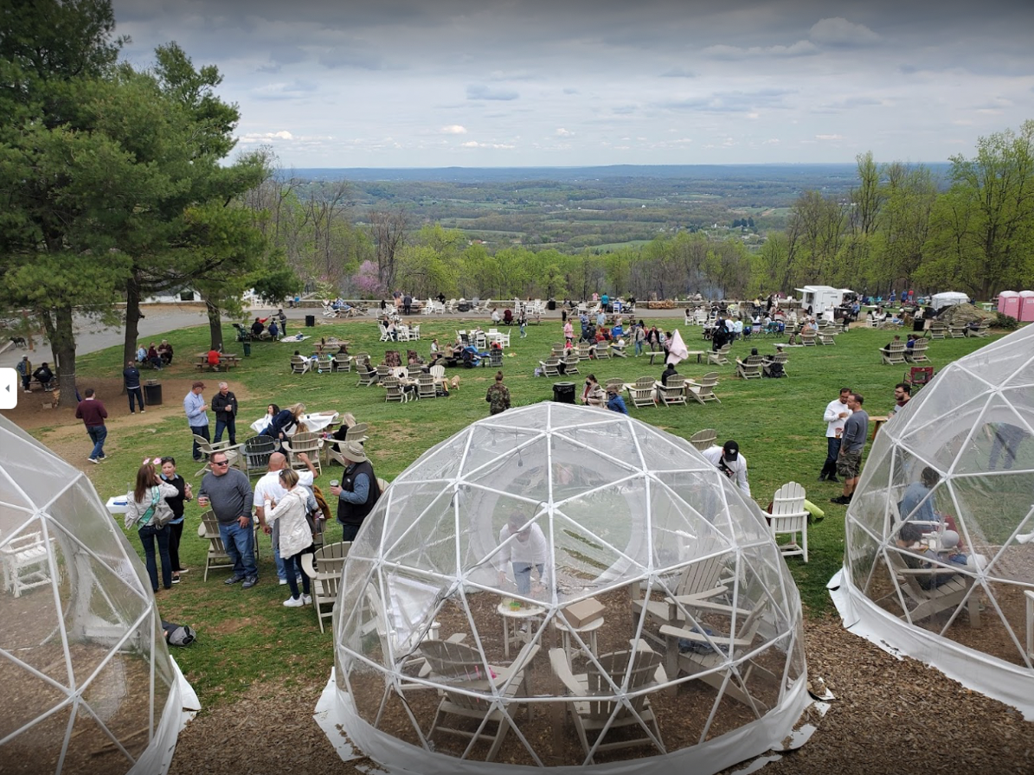
Growth and Land Use Pressures Around Us
Property owners along Town boundaries have expressed desire to develop properties
Town can only directly control
what is inside the Town limits
Examples of By-Right Commercial Development under Loudoun County Zoning

Slide 9
Housing Affordability
Lack of supply of entry-level homes to buy or rent
Need for workforce housing:
  Average Teacher Salary: $57,000*
  Need over 70 units just for teachers in Middleburg area*
  Public safety, administrative, hospitality, ag workers
Size of Houses have almost doubled since 1970
  Average size of house compared to 1970
  Average square feet per person compared to 1970
*Data comes from survey of all local Middleburg schools

Slide 10
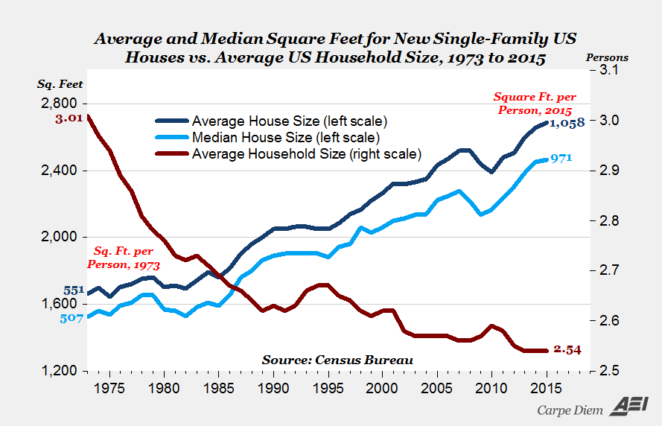
Housing Affordability – AEI Study

Slide 11
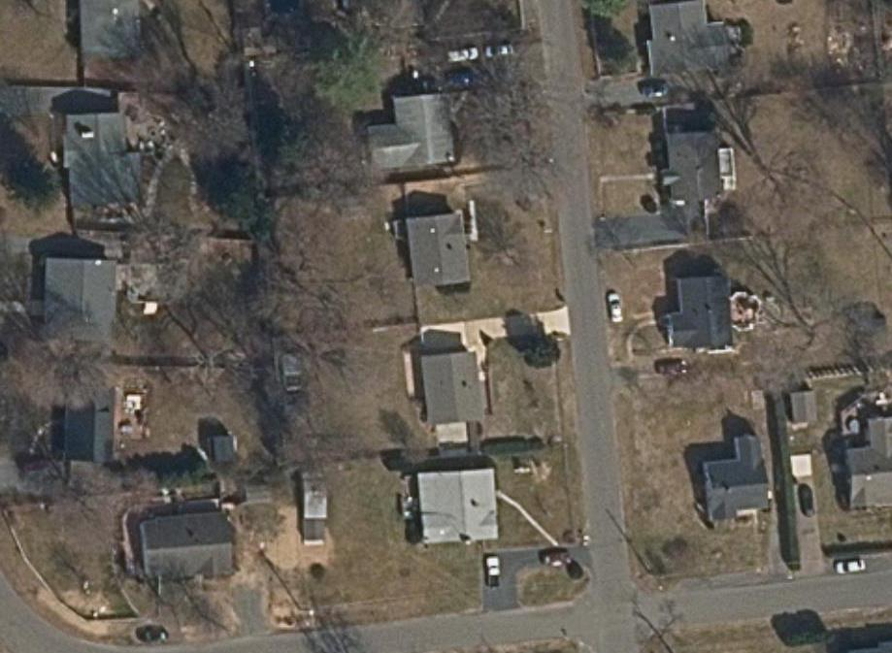
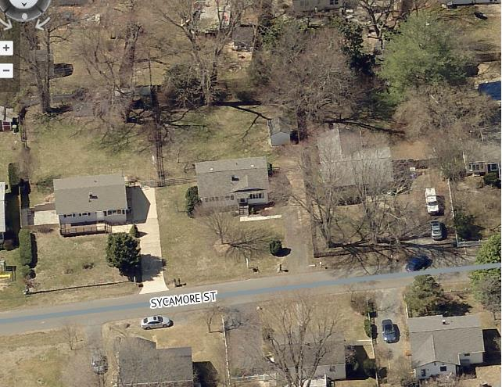
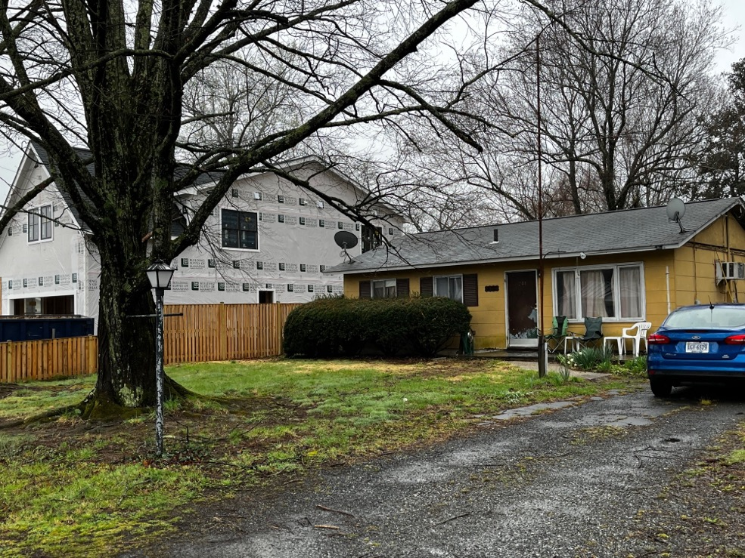
Housing Affordability
Tax Assessment
  Average Single-Family Home: $650,000
  Average Townhouse: $690,000
Recent teardowns and
new builds: $1M+ values
Loss of small lots and starter homes
  Example: 204 Sycamore

Slide 12
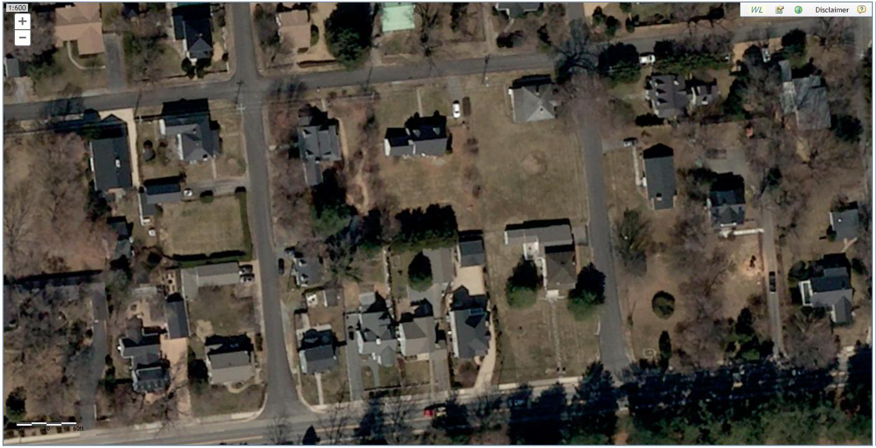
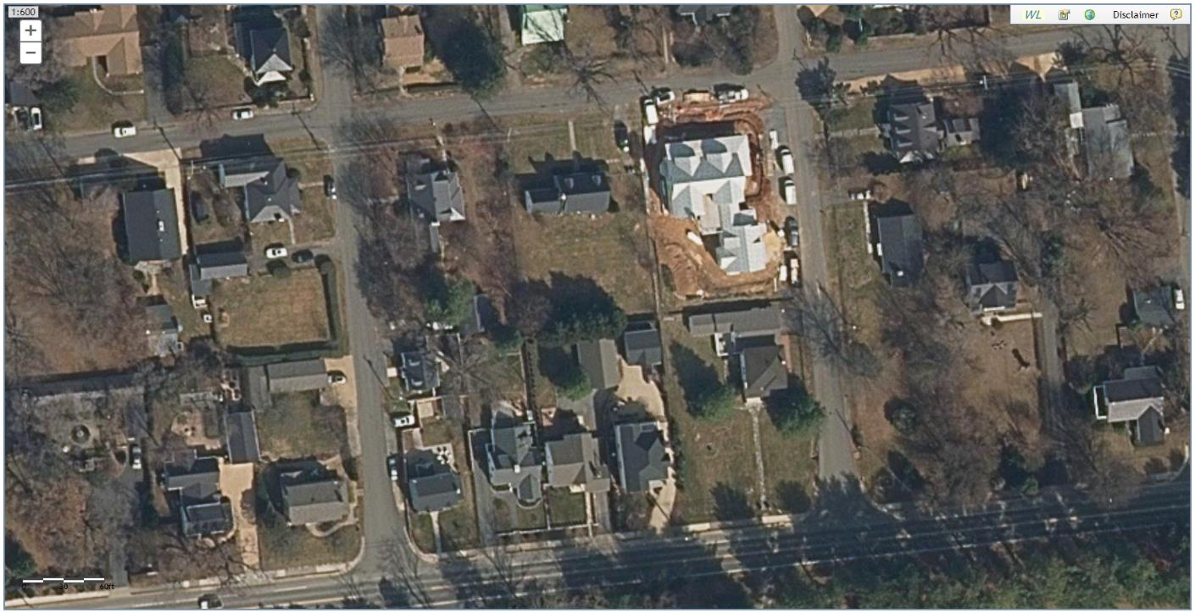
Housing Affordability Driven by Size

Slide 13
Subsidized Housing & small rentals
Entry-level Homes (rent or buy)
Mid-size Homes
($450k-$750k)
Larger Homes
($600k-$1.5m)
Missing segments of housing needs

Slide 14
Way Ahead: Workforce/Attainable Housing
Approved workforce housing as part of Salamander in 2007: workforce/teacher housing
  Have since said they do not plan to build these as originally approved
Working on new Zoning standards to limit tear-down & rebuild situations
Based on community input, Comprehensive Plan supports a variety of housing types with an eye toward affordability:
  “Maintain a diverse community of attractive neighborhoods that provide quality housing for an even wider range of residents in a style that matches the historic character of the Town.”

Slide 15
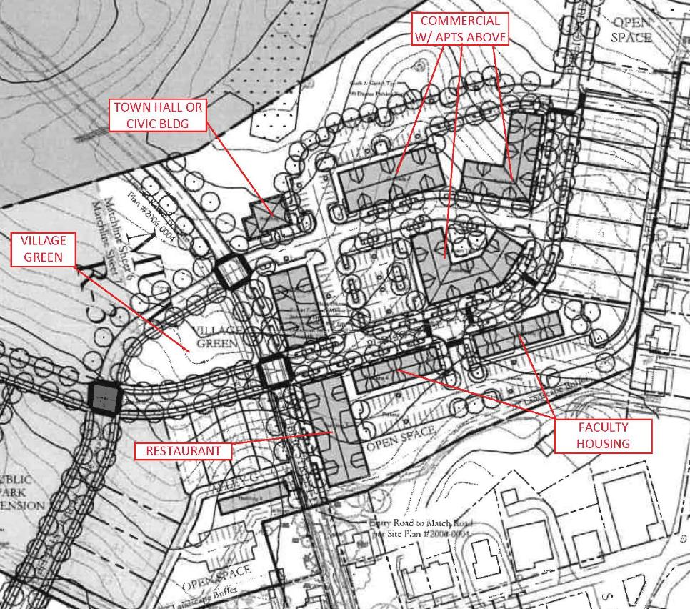
Mixed-Use-Village (MUV) 2007
Commercial with workforce housing above
Faculty Housing to serve Middleburg Charter, Hill School, Foxcroft, etc.
Total number of workforce condo units approved: 60

Slide 16
Way Ahead: Protective Greenbelt Around Middleburg
Ensured that greenbelt protective area was included in County Comprehensive Plan
Town Council has spoken against proposals that conflict with quality of life for Western Loudoun
Encouraging and supporting additional conservation easements

Slide 17
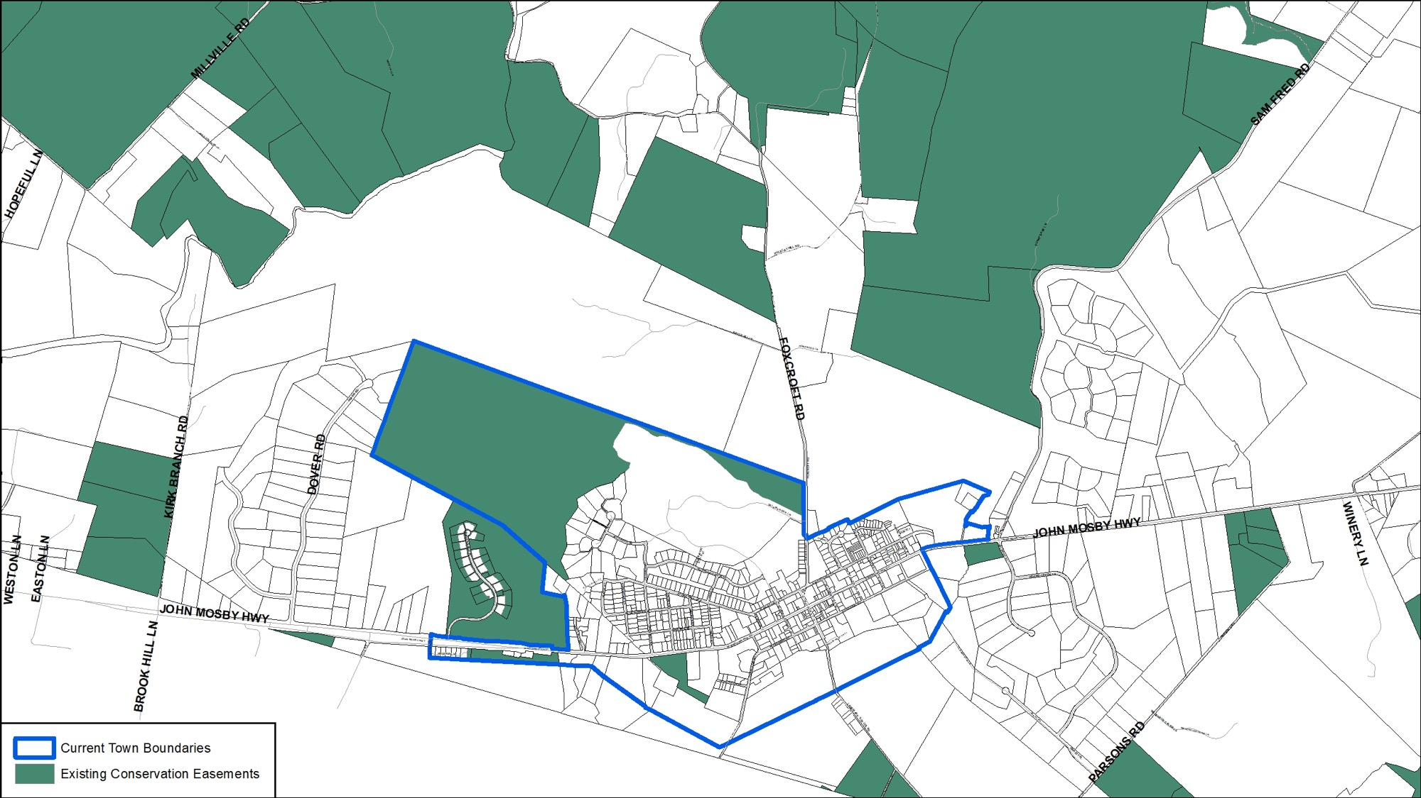
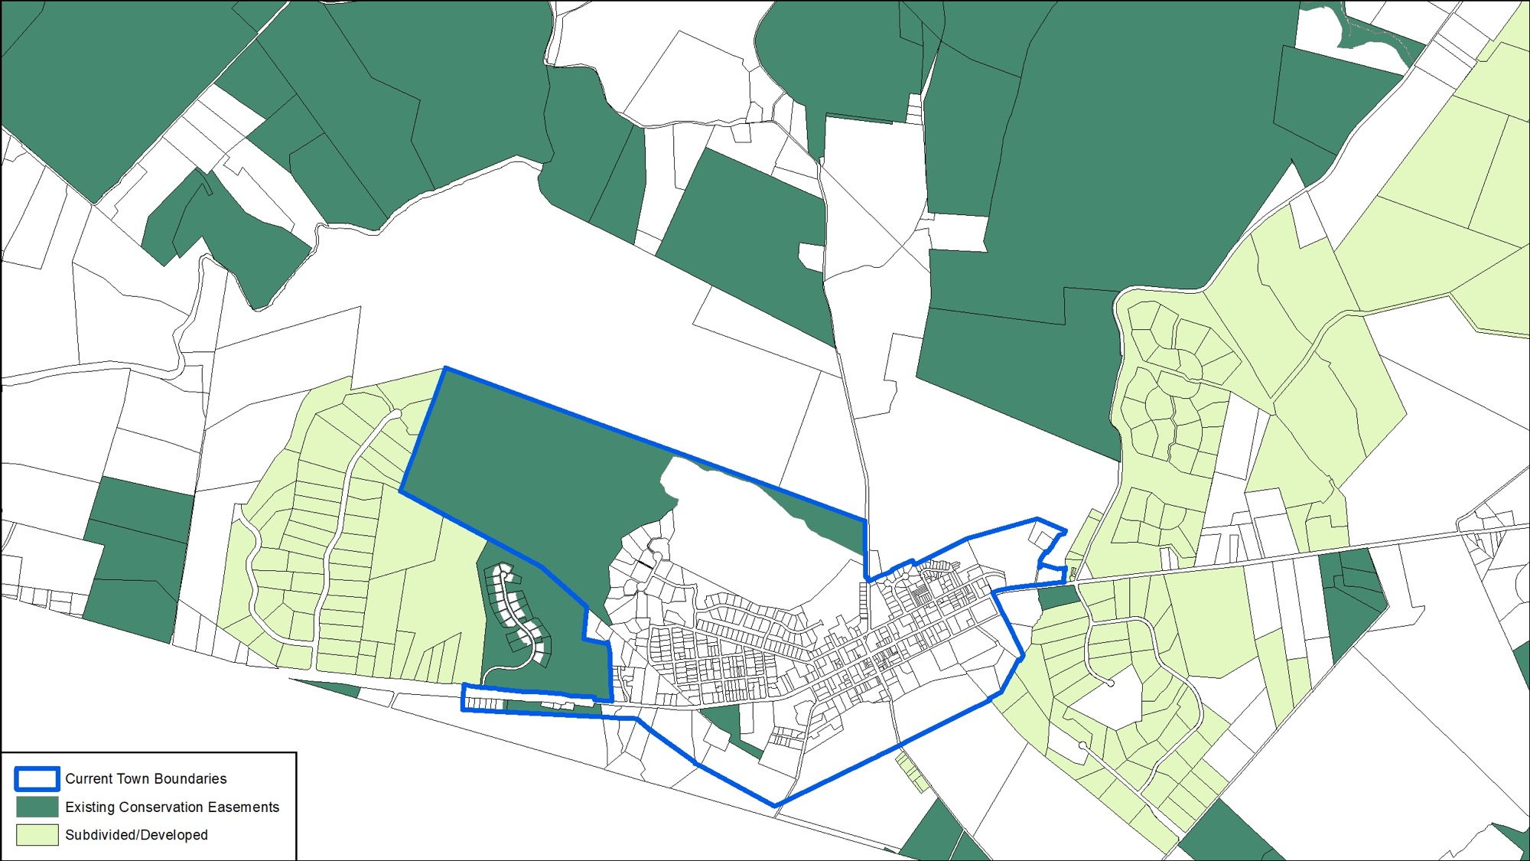
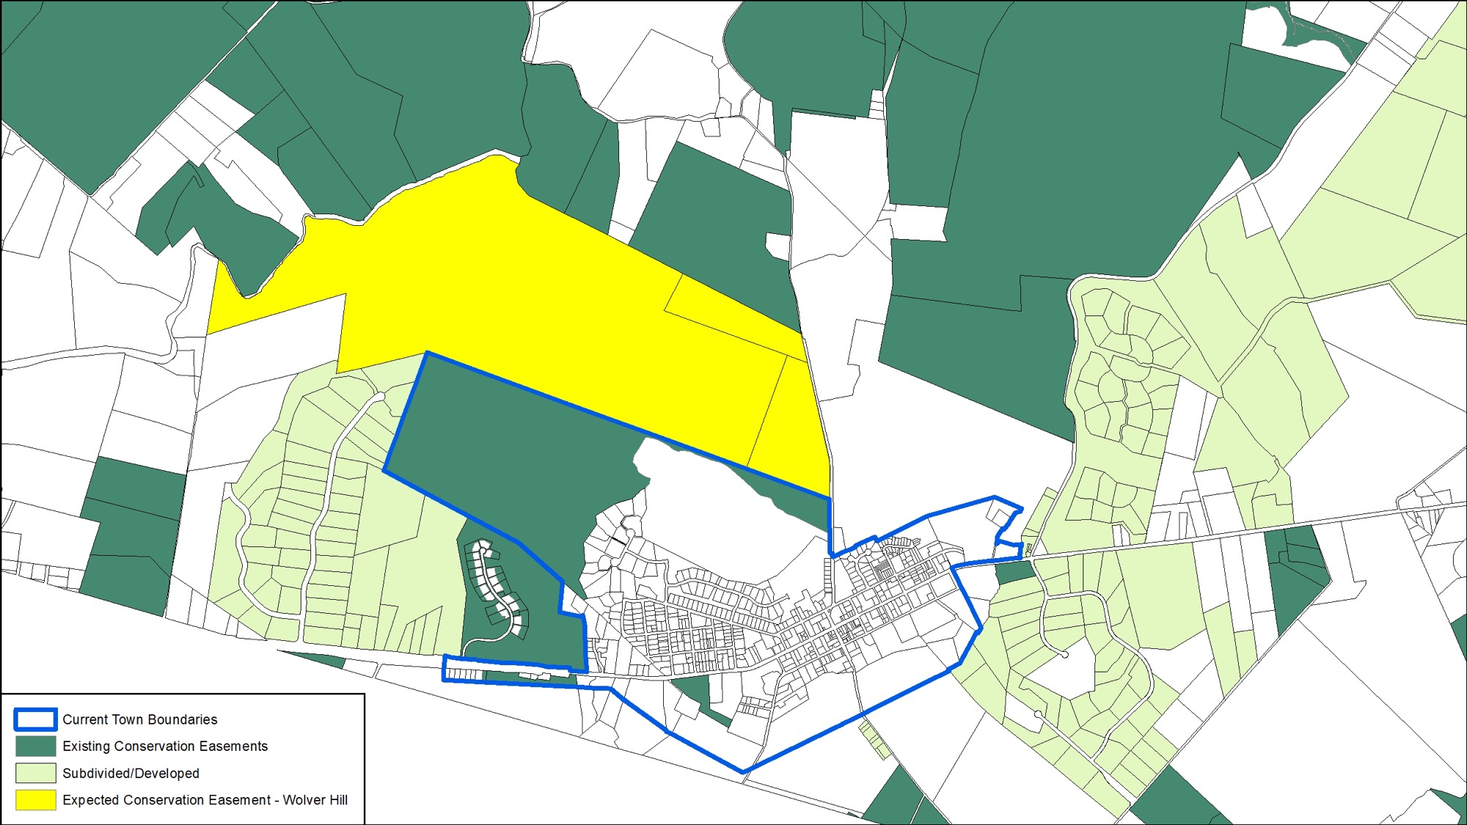
Protecting Green Belt Around Middleburg

Slide 18
Proposals for Annexation

Slide 19
Windy Hill Foundation Proposal
Approximately 33 acres in total
Creation of Additional Windy Hill Homes:
  20 Age-Restricted (same as Levis Hill House)
  40 Subsidized Units (either duplex or quadplex)
In early engineering – remainder of property protected through open space easements
All Town regulations related to roads, utilities, etc. will be followed:
  E.g., Extension of utilities paid by developer

Slide 20
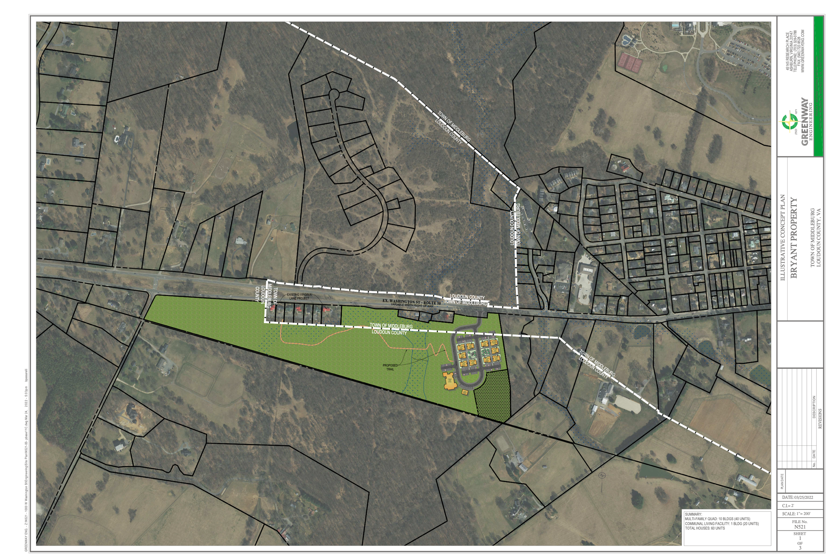

Slide 21
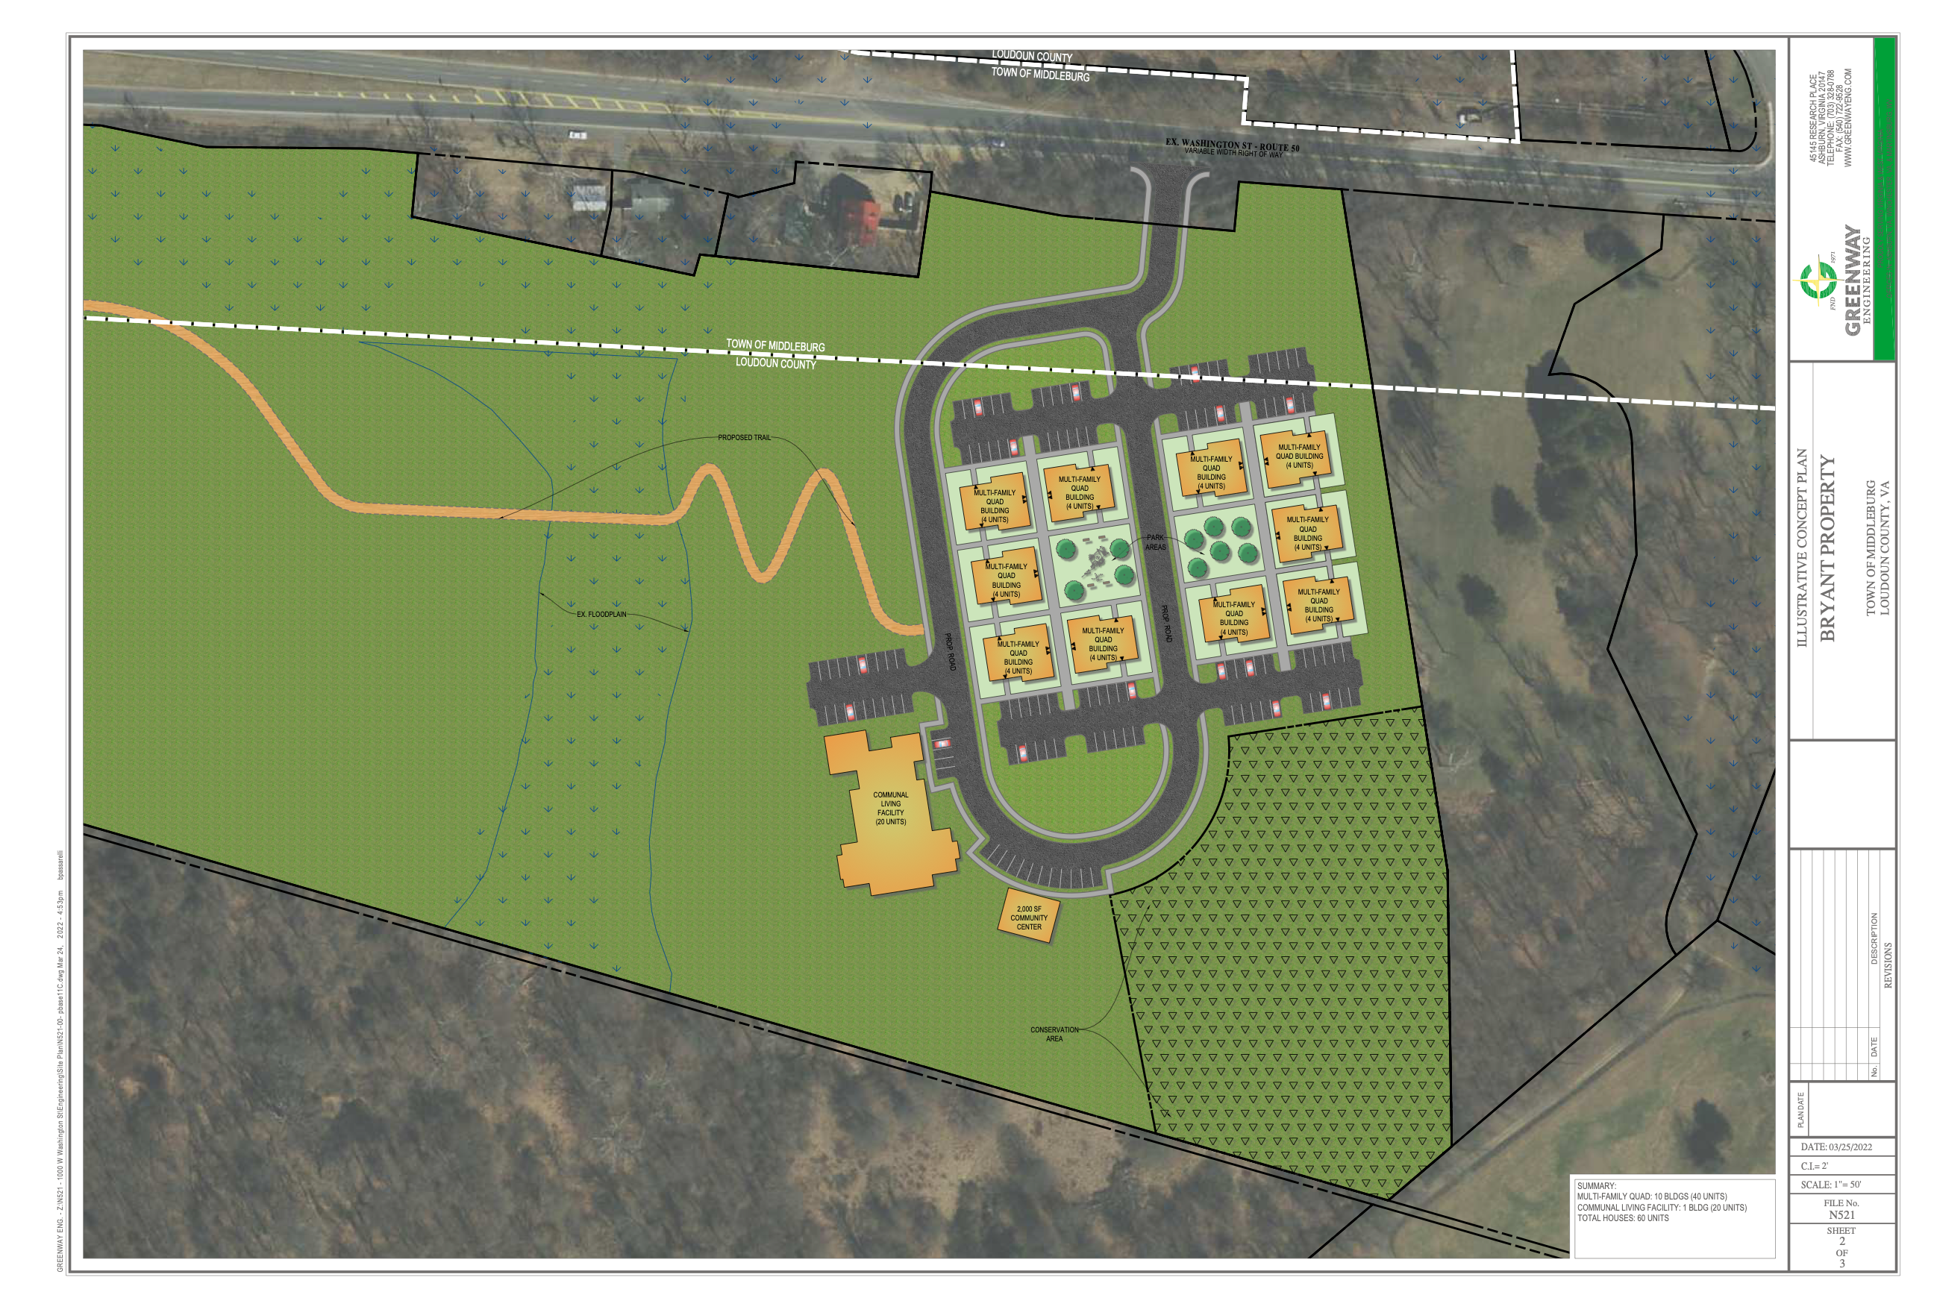

Slide 22
Windy Hill Proposal – Nature of Houses
Will be managed like other Windy Hill properties
Income-limits based on Area Median Income (AMI) for Loudoun County
Leased, not owned
Trails, services, access to community space

Slide 23
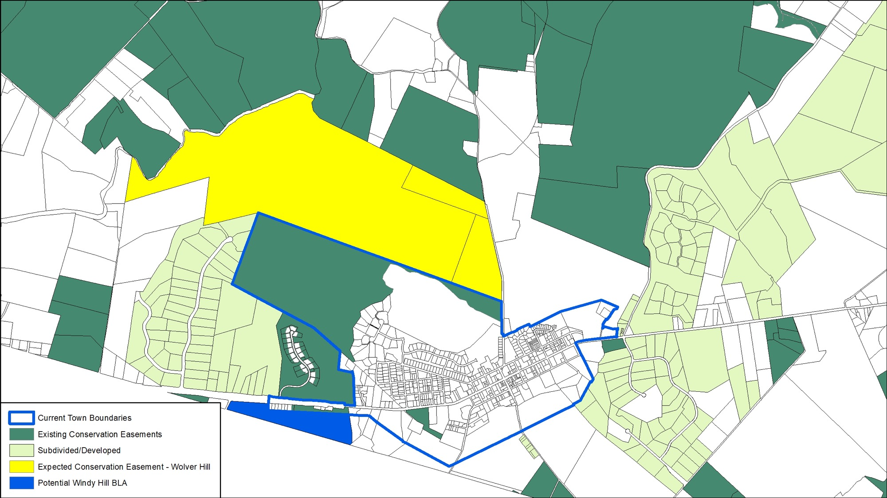

Slide 24
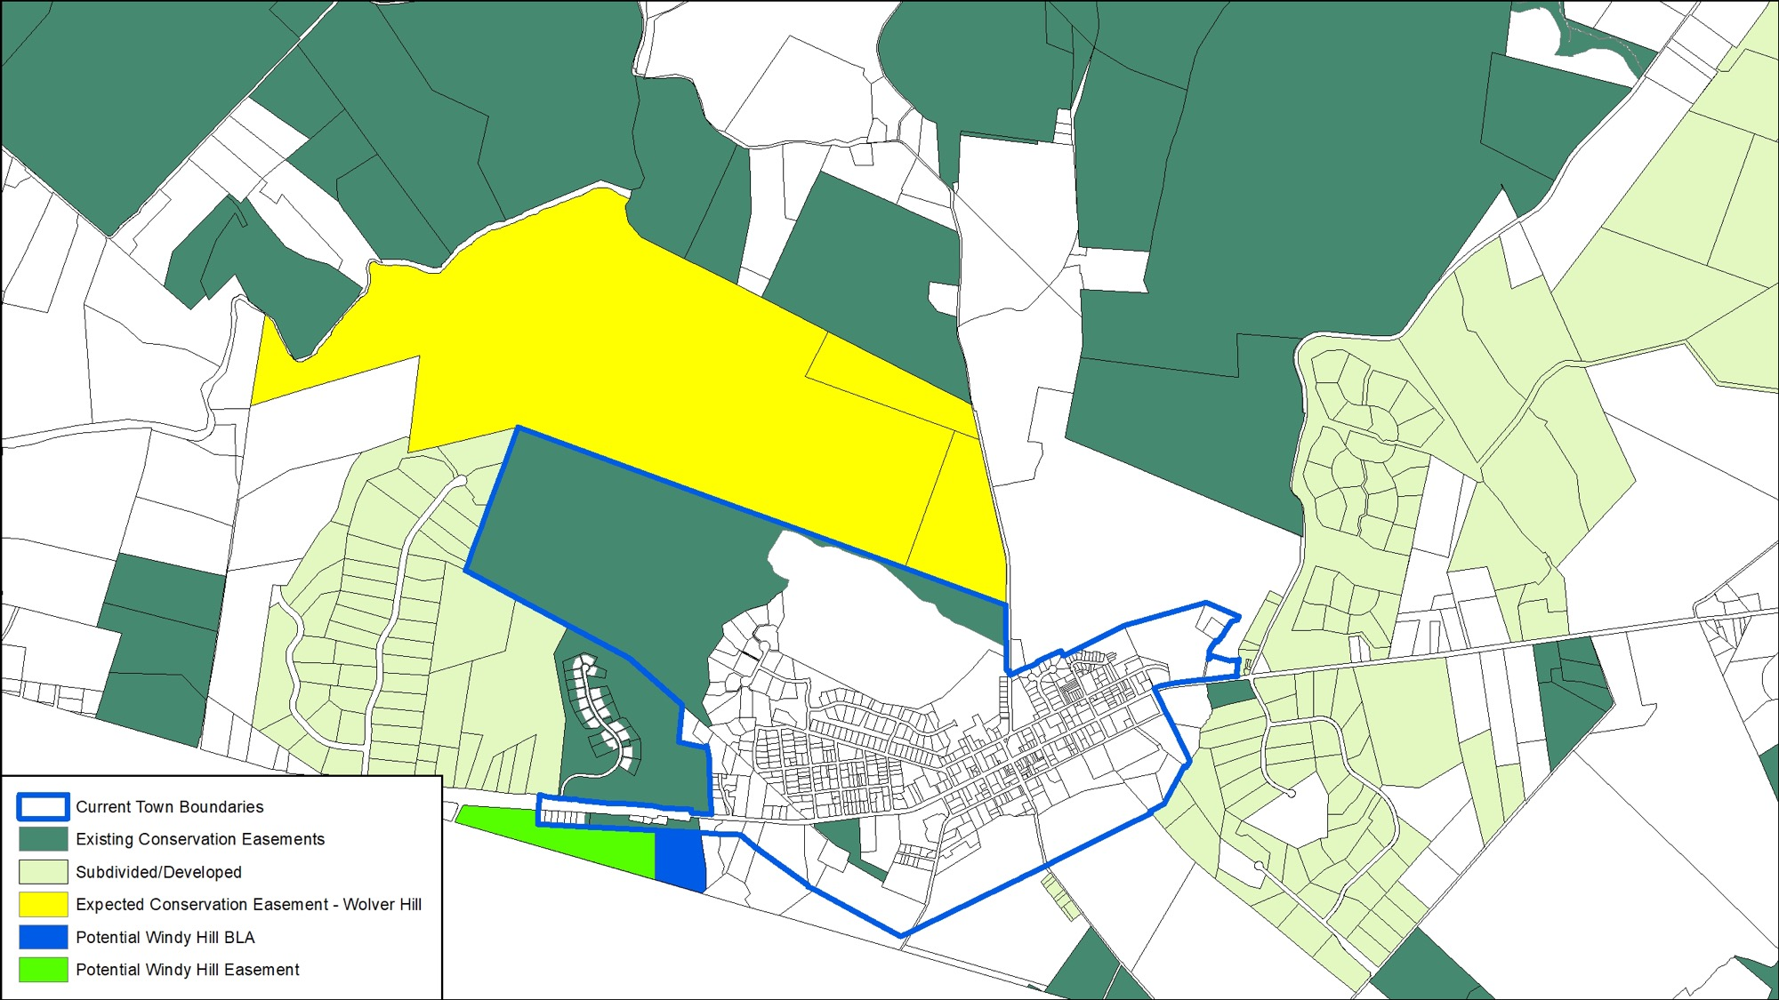

Slide 25
Quick Break – 10 minutes

Slide 26
Proposals for Annexation

Slide 27
Homewood Farm (former Pettibone Property)
Approximately 212 acres outside Town limits on Foxcroft Rd., east of Salamander and Wolver Hill
  Property already has 15 acres in Town
Annexation of approximately 22 acres into Town
  Remaining 190 acres would be placed in
  permanent open space conservation easement
Access off Foxcroft Road
  No access from Route 50

Slide 28
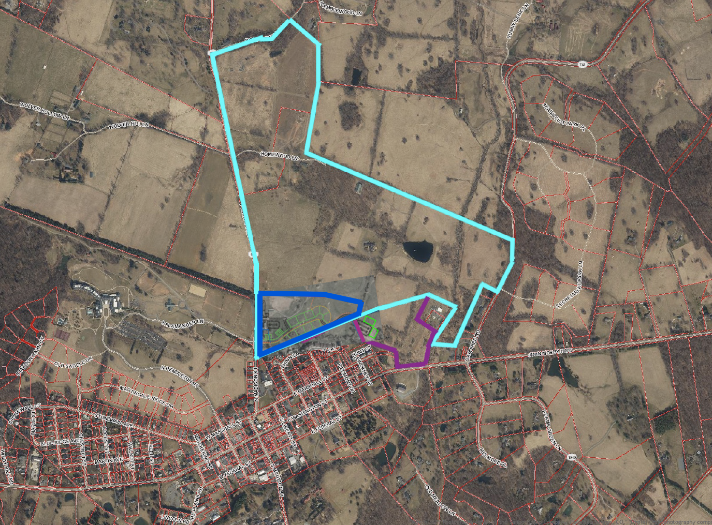
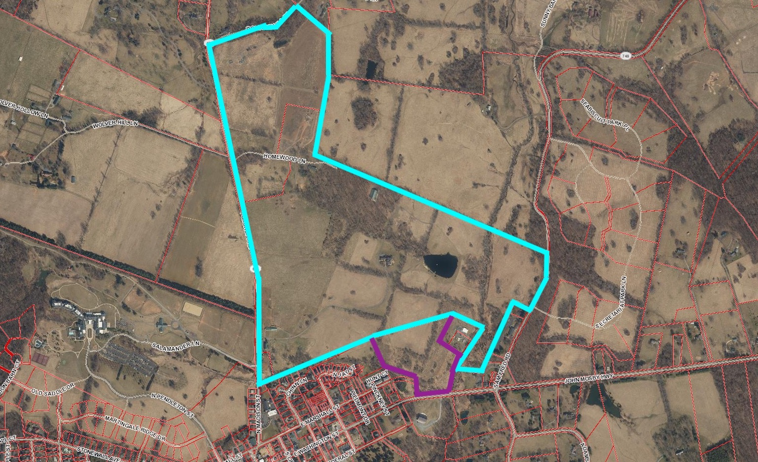

Slide 29
Homewood Farm (former Pettibone Property)
If Annexed:
  Proposed 66 Units in-Town
    48 condo units (1, 2, and 3 bedroom)
      Multifamily buildings maximum of 2-3 stories
    8 townhouse units
    10 single family cottage style homes
    Remaining 190 acres in conservation easement
  Limited commercial use in existing, renovated barn

Slide 30
Homewood Farm (former Pettibone Property)
If Not Annexed:
  Could develop like Banbury Cross – 14 by-right lots [clustered homes and rural economy lot(s)], and/or AR-2 commercial/ag uses
  Individual well/septic systems
  No Town control over uses, design standards, zoning, light/noise pollution, traffic or other Town ordinances

Slide 31
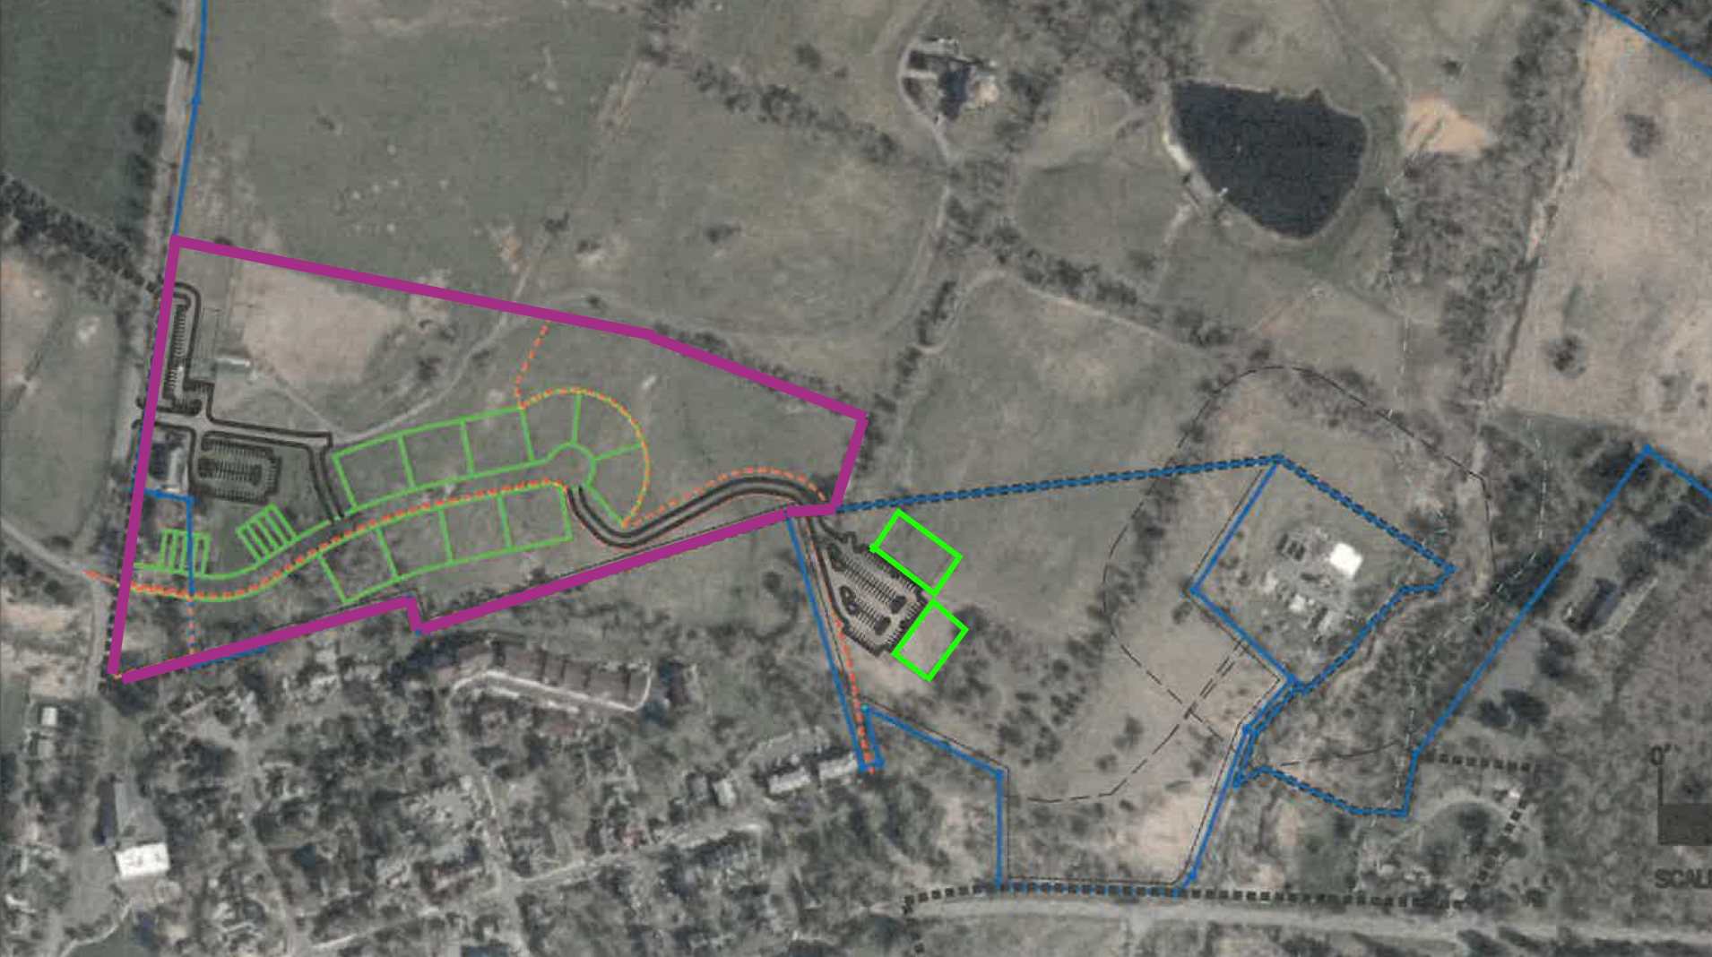

Slide 32
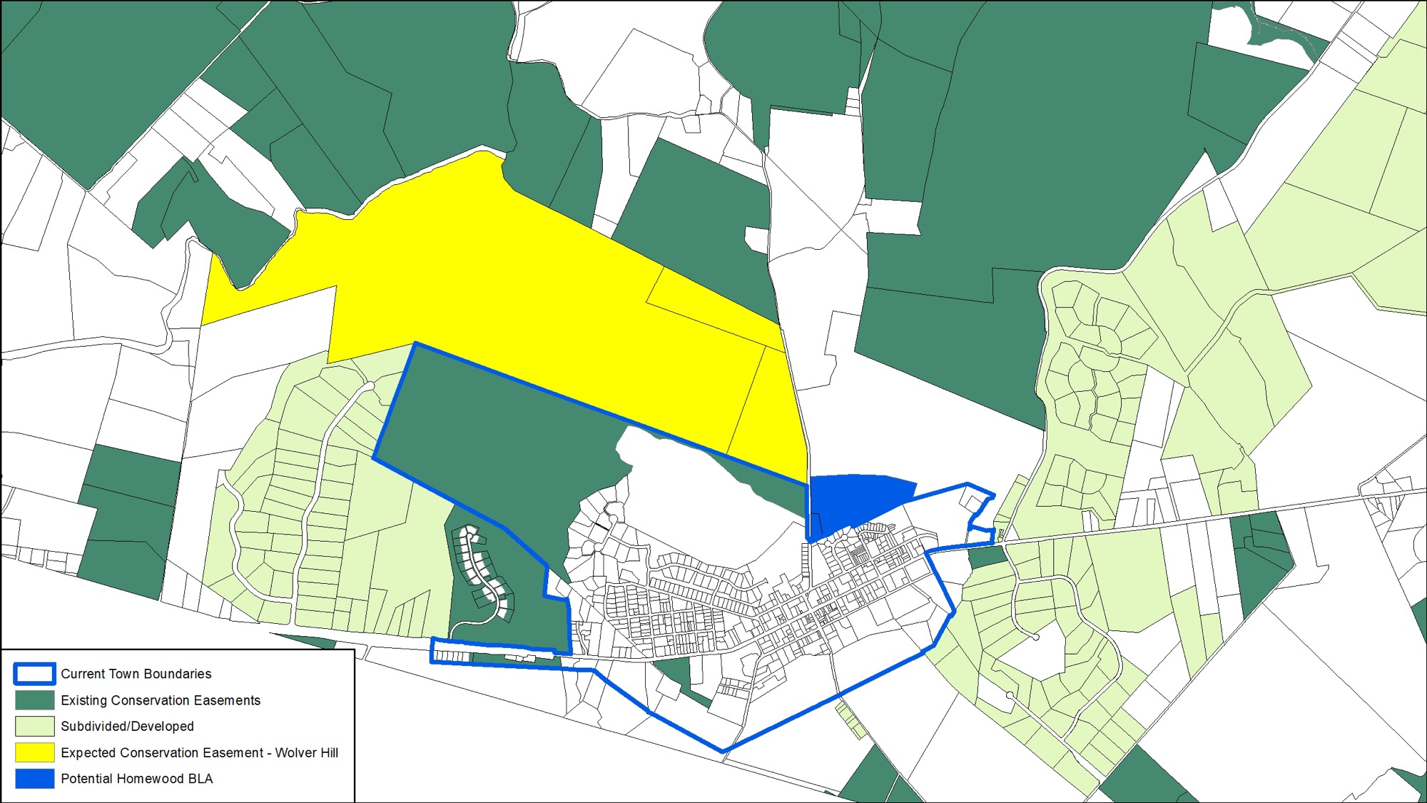

Slide 33
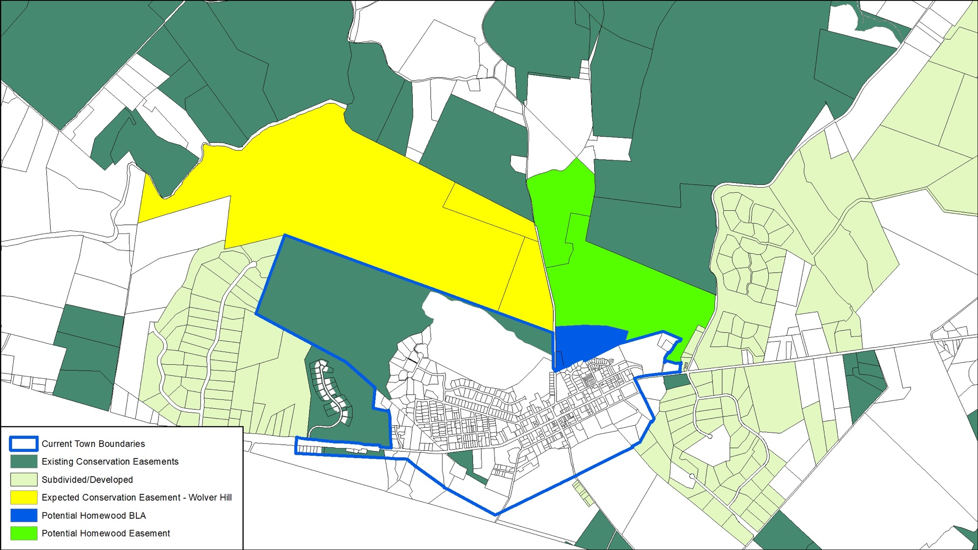

Slide 34
Considerations Related to Boundary Line Adjustments

Slide 35
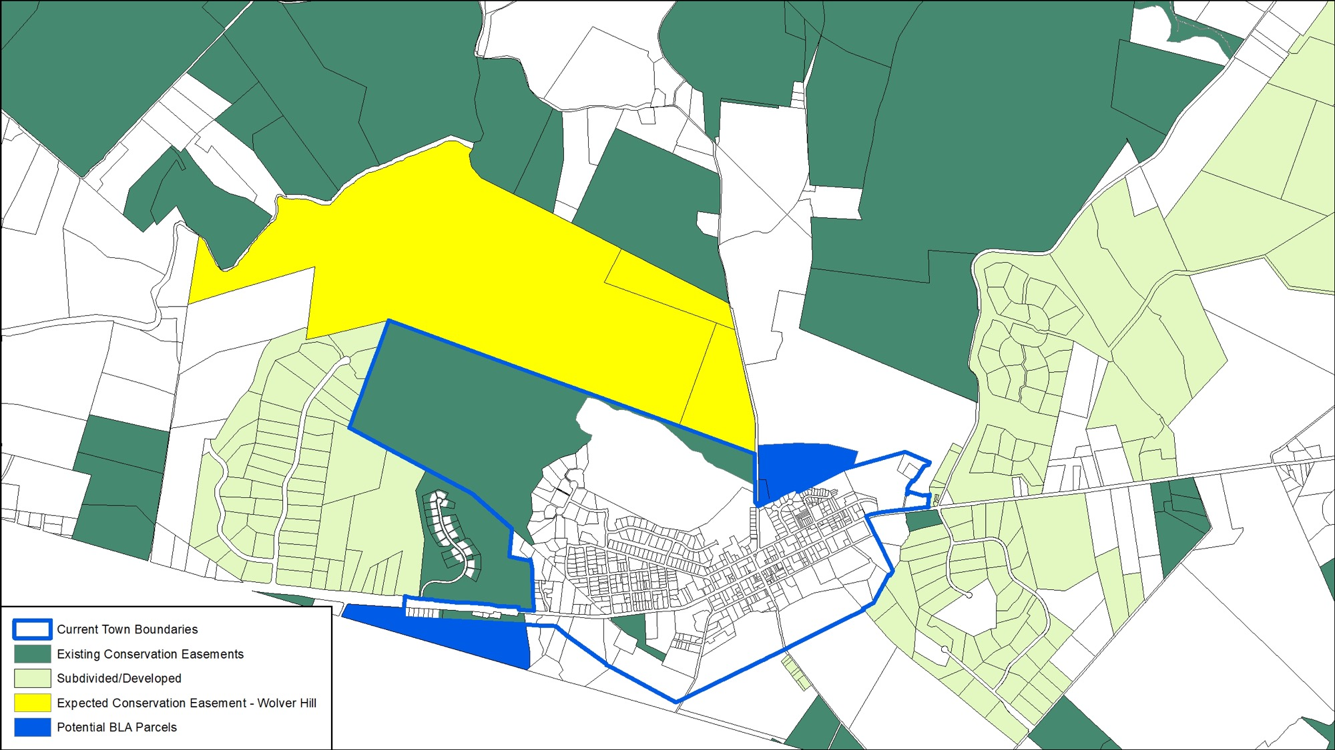
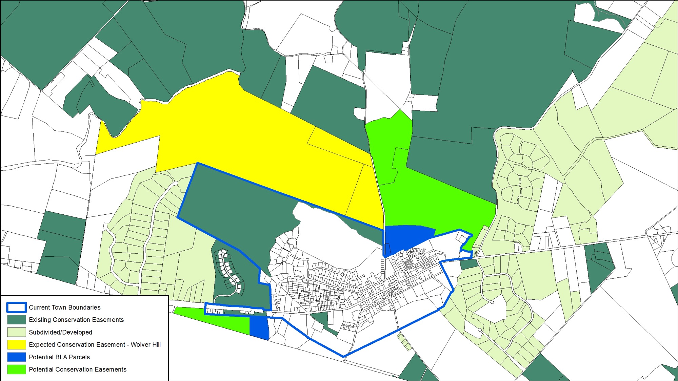

Slide 36

Considerations:
Town Operations
  Sufficient water/sewer capacity
  No capital expenditures paid by Town
  Future operational considerations
    Revenues may offset
  Connection fees apply
Impact on Traffic
  Work w/ VDOT to assess & address
Need for Pedestrian Connectivity

Slide 37
Subsidized Housing & small rentals
Entry-level Homes (rent or buy)
Mid-size Homes
($450k-$750k)
Larger Homes
($600k-$1.5m)
Missing segment of housing addressed

Slide 38
Next Steps

Slide 39

Next Steps:
Question and Answer Session
Continual Input from Community
  Online: middleburgva.gov/input
  Email: townclerk@middleburgva.gov
  Phone: 540-687-5152
  Town Council Meetings: 2nd & 4th Thursdays @ 6pm
Follow-up meeting: coming weeks
  Next several Council meetings will have dedicated public comment portion on BLA process and input

Slide 40
Questions & Answers

